Slide 1
Fundamentals of Business Lesson 3:Organizational environment
Instructor: P Pavalaxan
April 2024

Slide 2

Learning Outcome
Internal and external environment of organization
SWOT analysis

Slide 3
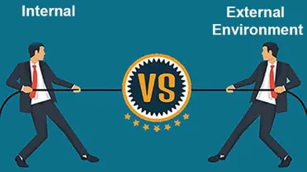

Organizational environment

Slide 4
Internal(Micro) environment
Forces or conditions or surroundings within the boundary of the organization are the elements of the internal environment of the organization.
Physical resources
Financial resources
Human resources
Information resources
Technological resources
Organization’s goodwill
Corporate culture

Slide 5
External(MACRO) environment
Factors outside or organization are the elements of the external environment. The organization has no control over how the external environment elements will shape up. Ex. PESTLE
Political
Economic
Sociocultural
Technological
Legal
Environmental (natural).

Slide 6
External(MACRO) environment
Political: Trade barriers, Tax policies, Political stability, International relations
Economic: Economic growth, Interest rates, Employment rates, Foreign exchange rates, Supply and demand, Cost of raw materials, Inflation rates, Consumer spending power
Sociocultural: Cultural trends, Population growth rates, Education levels, Income levels, Age distribution, Health consciousness, Lifestyles, Career attitudes
Technological: Technology, Technological infrastructure, Emerging technologies, Automation, Research
Legal: Health and safety, Equal opportunities, International trade, Advertising standards, Consumer rights, Product labelling, Product safety, Labor laws, Environmental laws
Environmental (natural): Weather, Scarcity of raw materials, Pollution, Climate change, Waste disposal, Agriculture, Sustainability practices

Slide 7
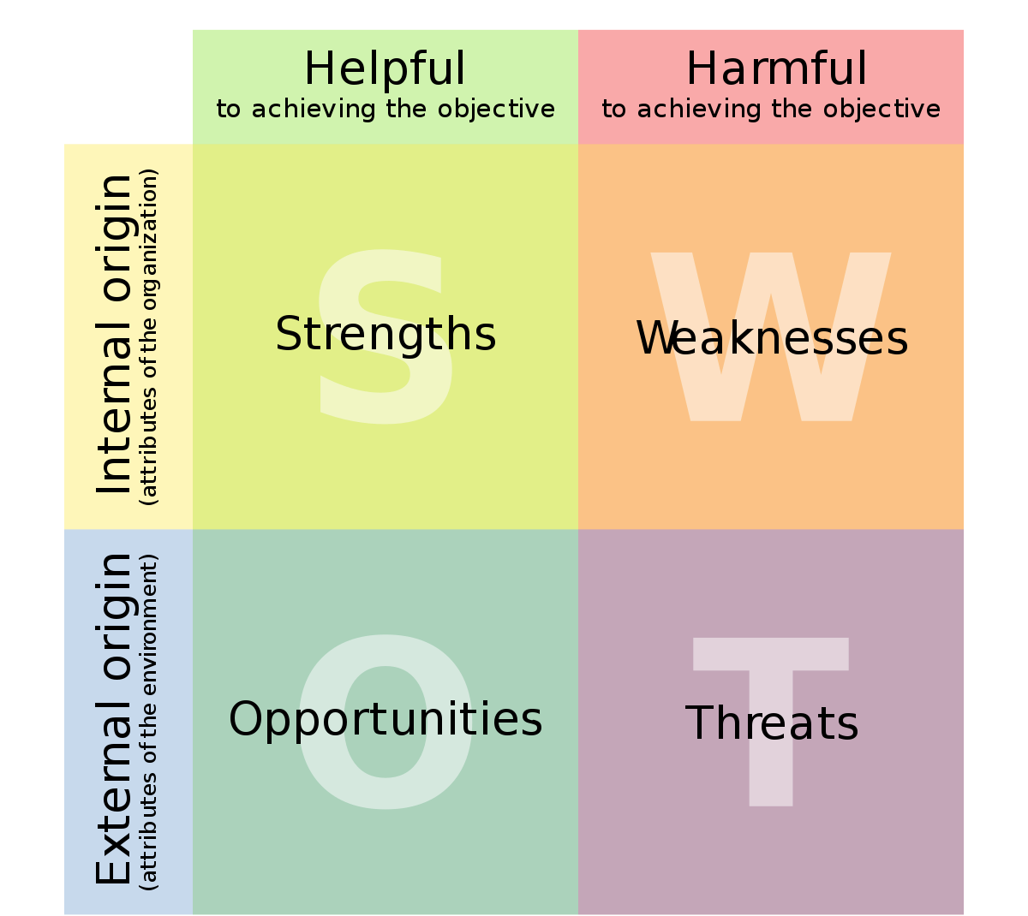
SWOT analysis

Slide 8
Strengths
Strengths are internal, positive attributes of your company. These are things that are within your control.
What business processes are successful?
What assets do you have in your teams? (ie. knowledge, education, network, skills, and reputation)
What physical assets do you have, such as customers, equipment, technology, cash, and patents?
What competitive advantages do you have over your competition?

Slide 9
Weaknesses
Weaknesses are negative factors that detract from your strengths. These are things that you might need to improve on to be competitive.
Are there things that your business needs to be competitive?
What business processes need improvement?
Are there tangible assets that your company needs, such as money or equipment?
Are there gaps on your team?
Is your location ideal for your success?

Slide 10
Opportunities
Opportunities are external factors in your business environment that are likely to contribute to your success.
Is your market growing and are there trends that will encourage people to buy more of what you are selling?
Are there upcoming events that your company may be able to take advantage of to grow the business?
Are there upcoming changes to regulations that might impact your company positively?
If your business is up and running, do customers think highly of you?

Slide 11
Threats
Threats are external factors that you have no control over. You may want to consider putting in place contingency plans for dealing with them if they occur.
Do you have potential competitors who may enter your market?
Will suppliers always be able to supply the raw materials you need at the prices you need?
Could future developments in technology change how you do business?
Is consumer behavior changing in a way that could negatively impact your business?
Are there market trends that could become a threat?

Slide 12
